Slide 1
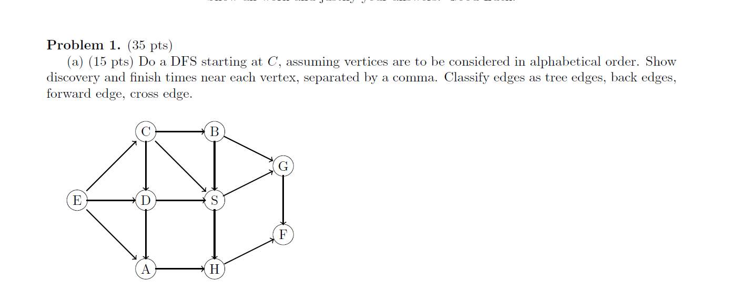
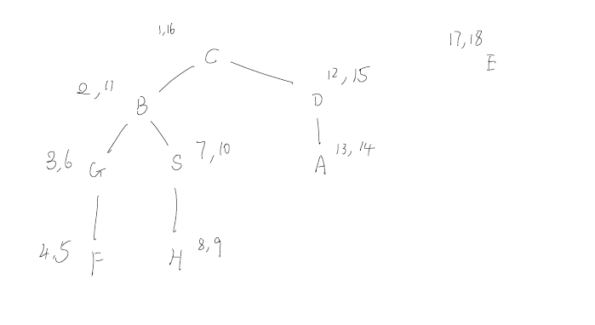
Tree: CB, BG, GF, BS, SH, CD, DA
Forward: CS
Backward:
Cross: EC, EA, ED, DS, AH, SG, HF

Slide 2
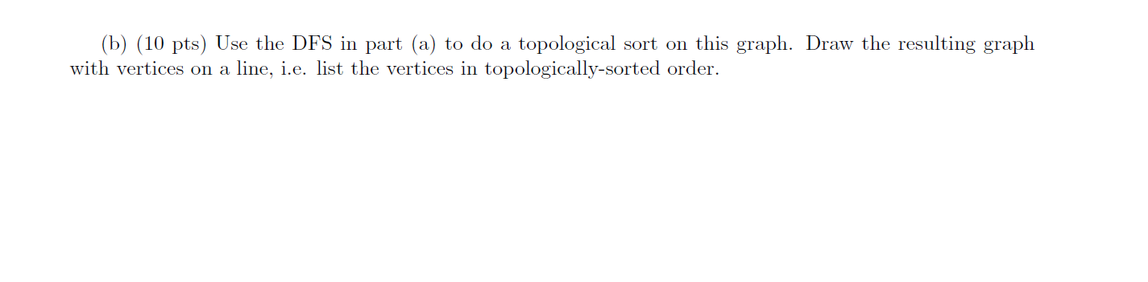
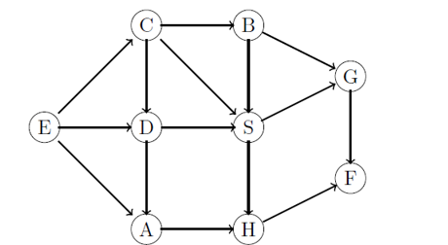
E, C, D, A, B, S, H, G, F

Slide 3
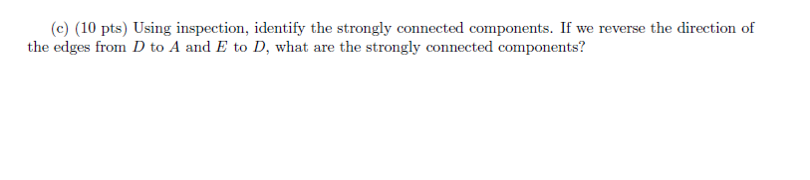
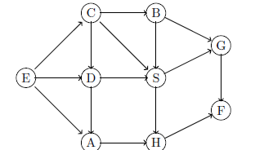
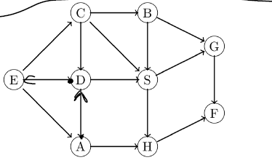
First part: {E}, {D}, {A}, {C}, {B}, {S}, {H}, {G}, {F}
Second part (after changing directions of the two edges): {E, D, A, C}, {B}, {S}, {H}, {G}, {F}

Slide 4
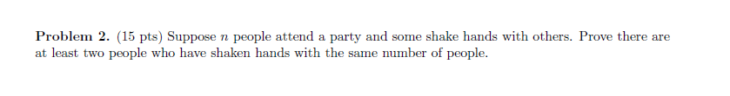
Each person at the party can only shake hands with 0 to n-1 people. If everyone shook hands with someone, then it cannot be the case that one person shook hands with 0 people. So, either there is a case of 0 or n-1, but not both. This is n-1 possibilities. By pigeonhole principle, two people must shake hands with the same number of people.

Slide 5
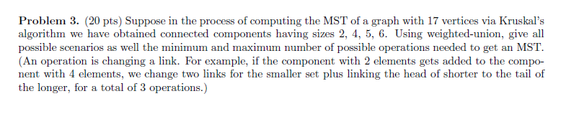
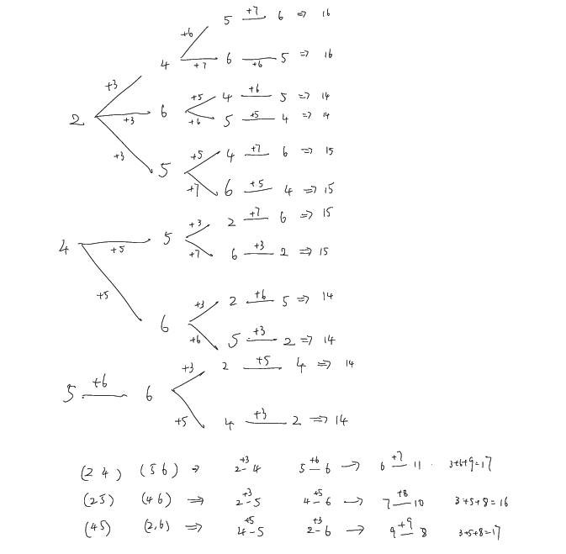
MIN: 14, MAX: 17. ~15 cases

Slide 6
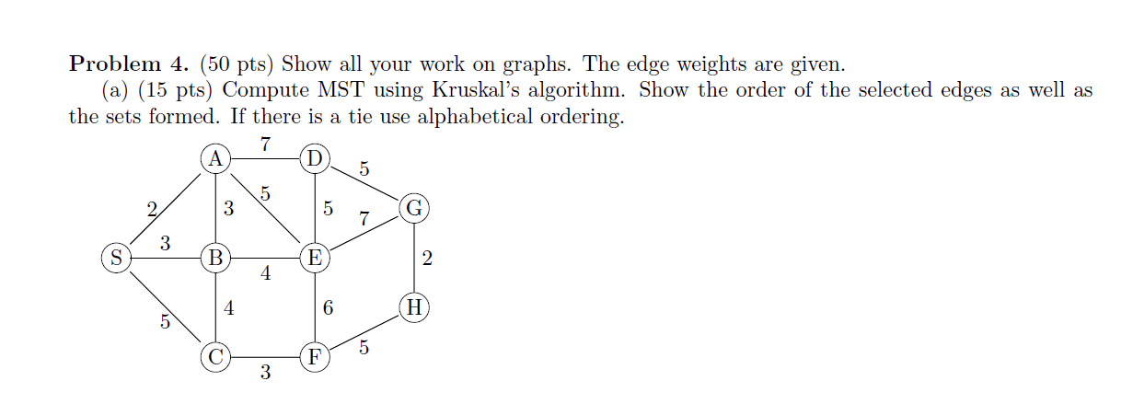
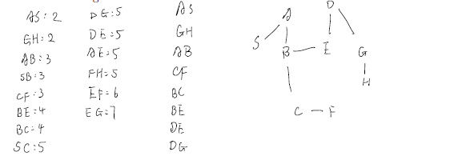
Order: AS, GH, AB, CF, BC, BE, DE, DG

Slide 7
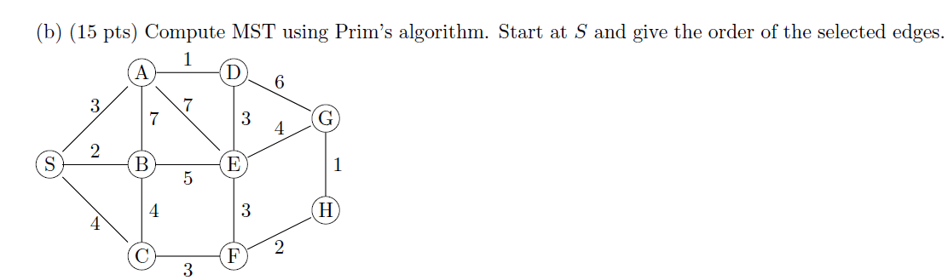
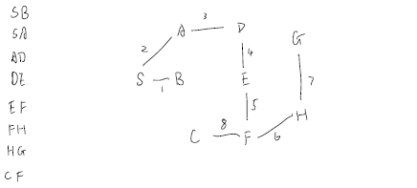
Order: SB, SA, AD, DE, EF, FH, HG, CF

Slide 8
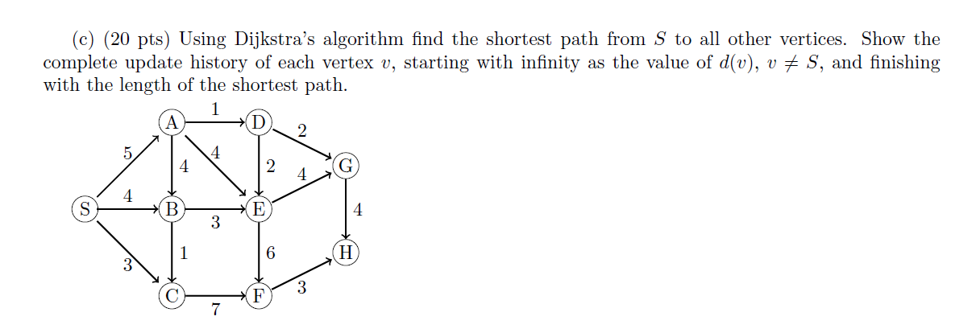
Iteration | S | A | B | C | D | E | F | G | H
0 | 0, Nil | Inf , Nil | Inf , Nil | Inf , Nil | Inf , Nil | Inf , Nil | Inf , Nil | Inf , Nil | Inf , Nil
1 | 0, NIL | 5, S | 4, S | 3, S | Inf , Nil | Inf , Nil | Inf , Nil | Inf , Nil | Inf , Nil
2 | − | 5, S | 4, S | 3, S | Inf , Nil | Inf , Nil | 10, C | Inf , Nil | Inf , Nil
3 | − | 5, S | 4, S | − | Inf , Nil | 7, B | 10, C | Inf , Nil | Inf , Nil
4 | − | 5, S | − | − | 6, A | 7, B | 10, C | Inf , Nil | Inf , Nil
5 | − | − | − | − | 6, A | 7, B | 10, C | 8, D | Inf , Nil
6 | − | − | − | − | − | 7, B | 10, C | 8, D | Inf , Nil
7 | − | − | − | − | − | − | 10, C | 8, D | 12, G
8 | − | − | − | − | − | − | 10, C | − | 12, G
9 | − | − | − | − | − | − | − | − | 12, G
Lengths of shortest paths
from S to every other vertex:
d(A) = 5
d(B) = 4
d(C) = 3
d(D) = 6
d(E) = 7
d(F) = 10
d(G) = 8
d(H) = 12

Slide 9
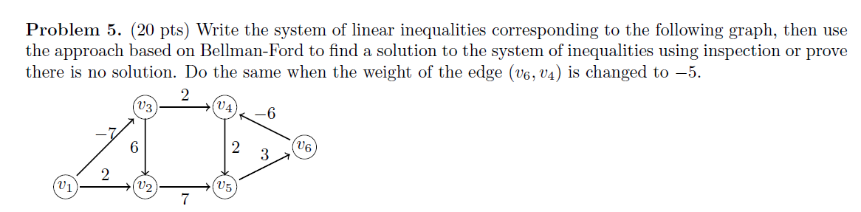
First part:
v3 - v1 <= -7
v2 - v1 <= 2
v2 - v3 <= 6
v5 - v2 <= 7
v4 - v3 <= 2
v5 - v4 <= 2
v4 - v6 <= -6
v6 - v5 <= 3
No solution: v4-v5-v6 negative cycle.

Slide 10
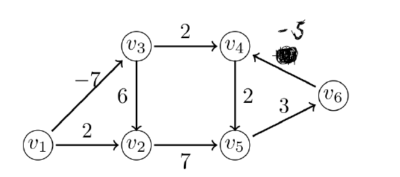
Iteration | v0 | v1 | v2 | v3 | v4 | v5 | v6
0 | 0, Nil | Inf, Nil | Inf, Nil | Inf, Nil | Inf, Nil | Inf, Nil | Inf, Nil
1 | 0, Nil | 0, v0 | 0, v0 | −7, v1 | −5, v3 | −3, v4 | 0, v0
2 | 0, Nil | 0, v0 | −1, v3 | −7, v1 | −5, v3 | −3, v4 | 0, v0
3 | 0, Nil | 0, v0 | −1, v3 | −7, v1 | −5, v3 | −3, v4 | 0, v0
4 | 0, Nil | 0, v0 | −1, v3 | −7, v1 | −5, v3 | −3, v4 | 0, v0
5 | 0, Nil | 0, v0 | −1, v3 | −7, v1 | −5, v3 | −3, v4 | 0, v0
6 | 0, Nil | 0, v0 | -1, v3 | -7, v1 | -5, v3 | -3, v4 | 0, v0
v1: 0
v2: -1
v3: -7
v4: -5
v5: -3
v6: 0

Slide 11
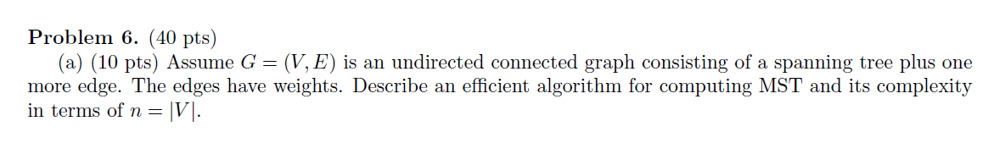
Constructing New Graph G’ with MST and missing edge
Run DFS on G’ to find the cycle. Start from a node on the missing edge
Remove the edge with maximum weight in the cycle
Complexity: Let n = |V|
O(|V| + |E|) = O(n + n) = O(n) time for DFS

Slide 12
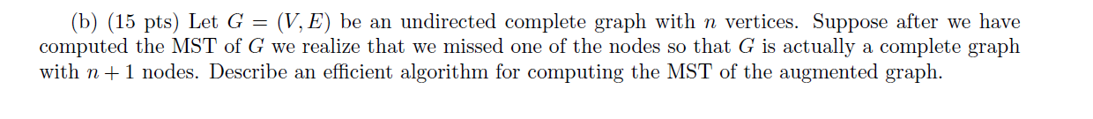
Create the graph G' using the edges from the MST and the n edges coming from the new vertex.
Run Prim's Algorithm with the new vertex as the starting vertex.
Return the MST from the algorithm from step 2.The runtime would be O(n log n) since the number of edges being considered is on the order of n (or 2n - 1 to be exact).
This is much better than Prim's or Kruskal's, which would be O(|E|log|V|) ~= O(n^2logn)

Slide 13
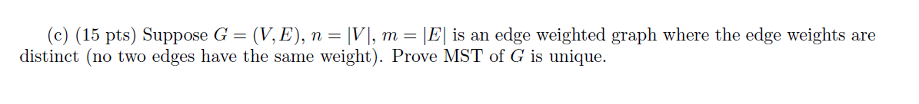
c) Let T and T' be distinct MSTs for G. Pick the edge e = (x, y) with minimum weight such that this edge is in either T or T', but not both. WLOG assume e in T. The weight of e must be greater than the weights of every edge f on the path from x to y in T' (otherwise e would've been included in T'). But, this means that all of those edges f must be in T as well. Since e is in T, this creates a cycle in T, contradicting the assumption T is a tree.

Slide 14
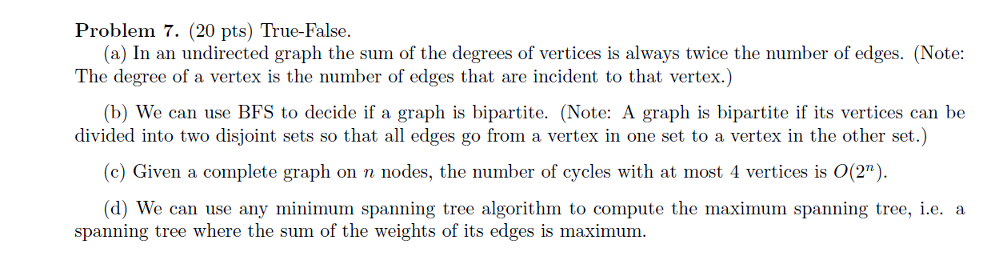
a) True
b) True
c) True
d) True

